Slide 1
Introduction to CyberSecurity
Sreya Vangara

Slide 2
How Do Computers Communicate?

Slide 3
Networks
Local Area Networks (LANs) are the “physical” networks
The IP, or Internet Protocol, layer connects multiple LANs into the Internet.
TCP (Transmission Control Protocol) deals with transport and connections and actually sending user data.
Notes:
http://intronetworks.cs.luc.edu/current/html/intro.html

Slide 4
Find Your IP
https://www.ipchicken.com/
Command prompt/terminal: ipconfig

Slide 5
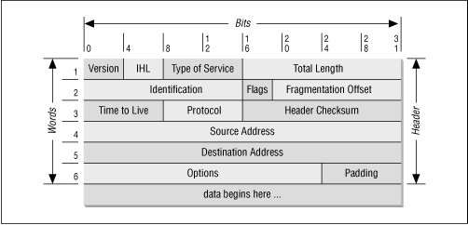
Data Packet

Slide 6
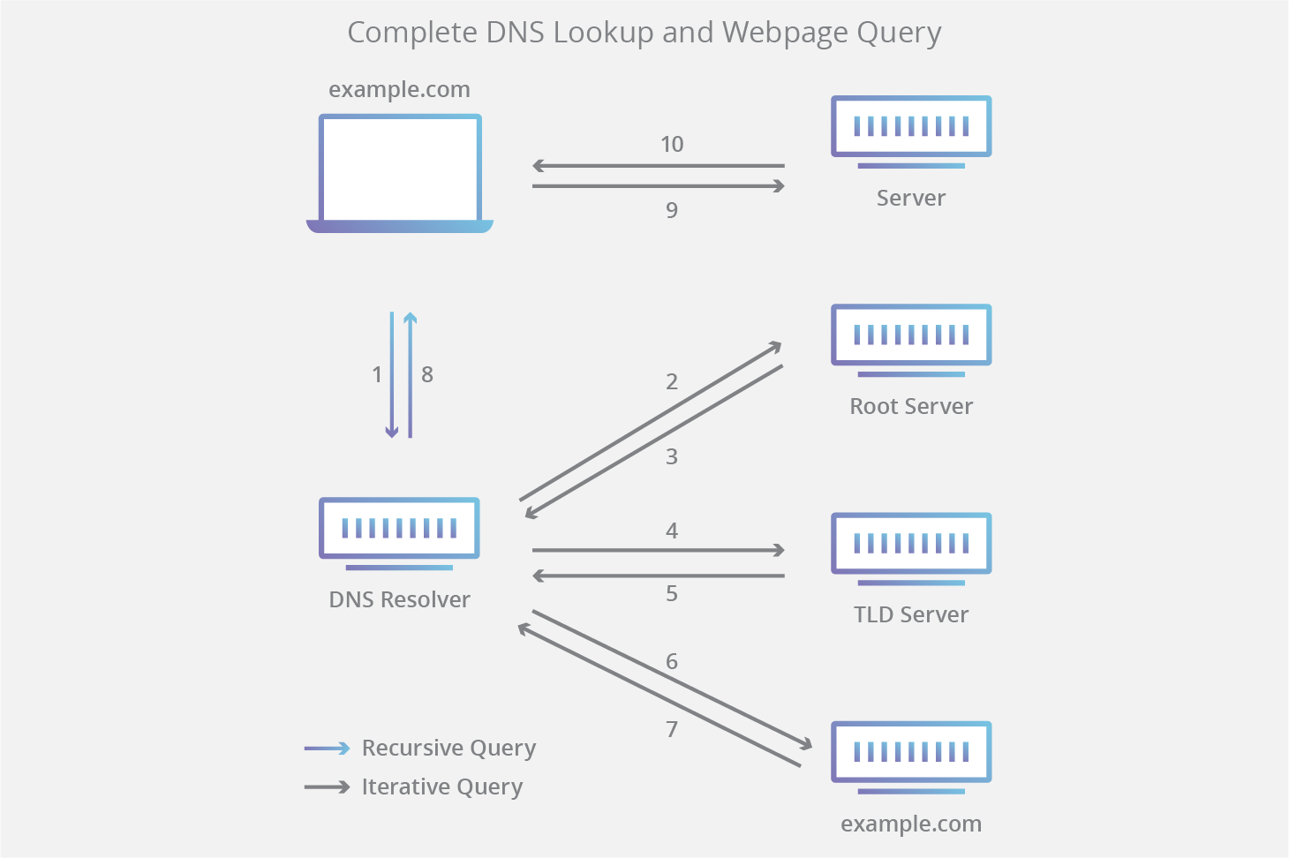
DNS

Slide 7
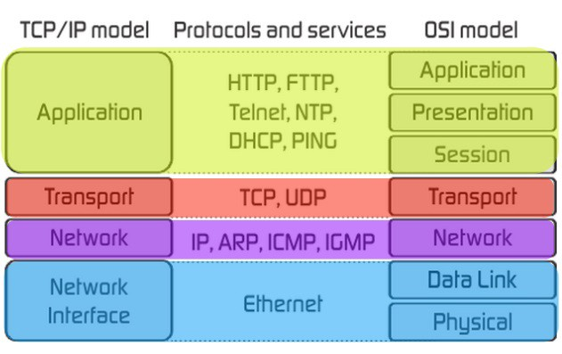
ME
YOU

Slide 8
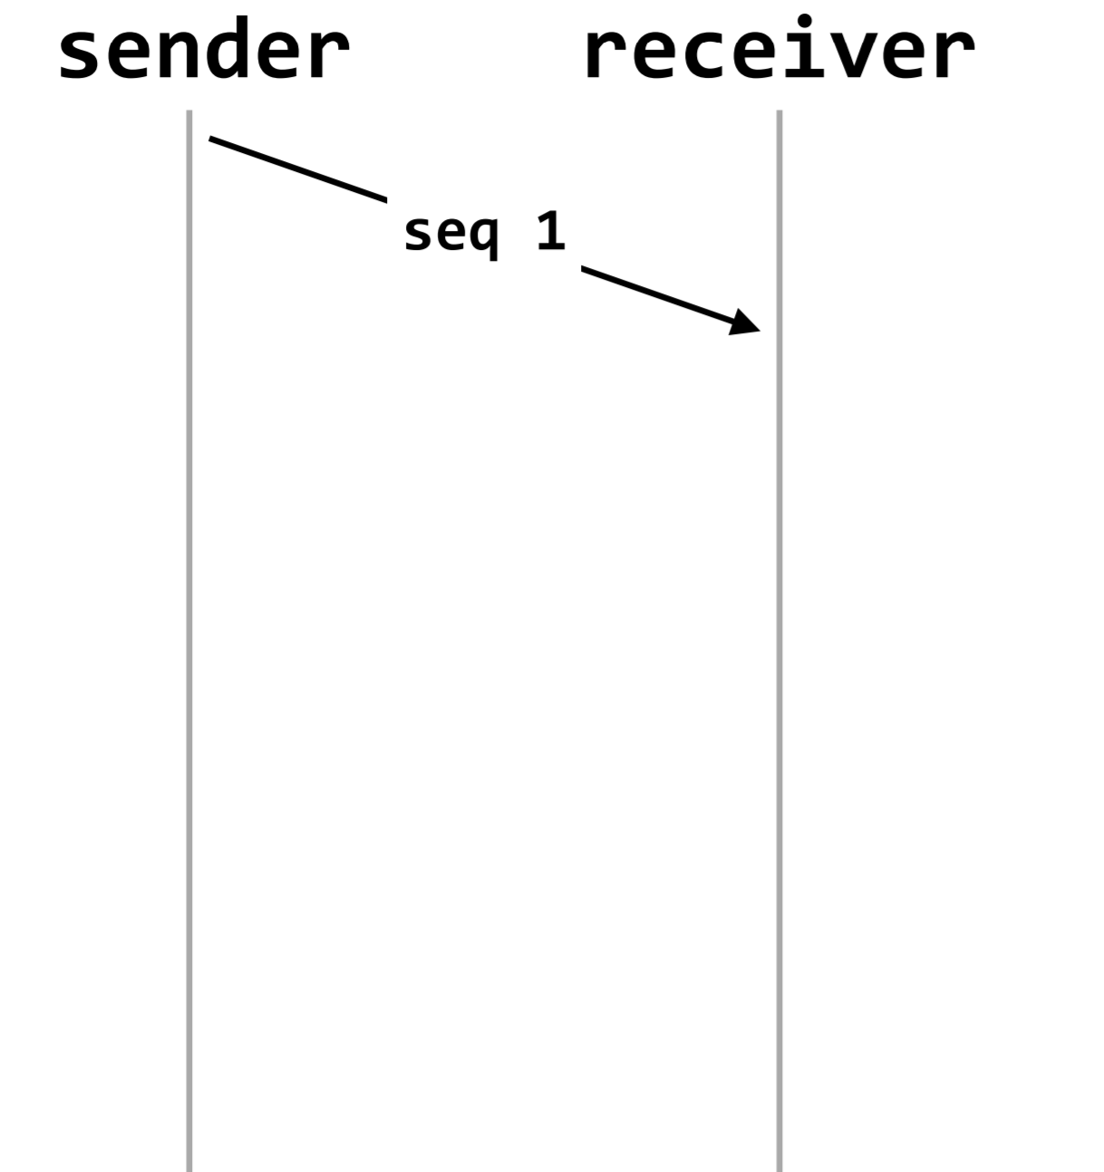
Come Up With a Protocol!

Slide 9
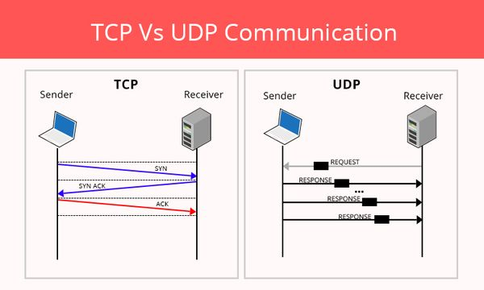

Slide 10
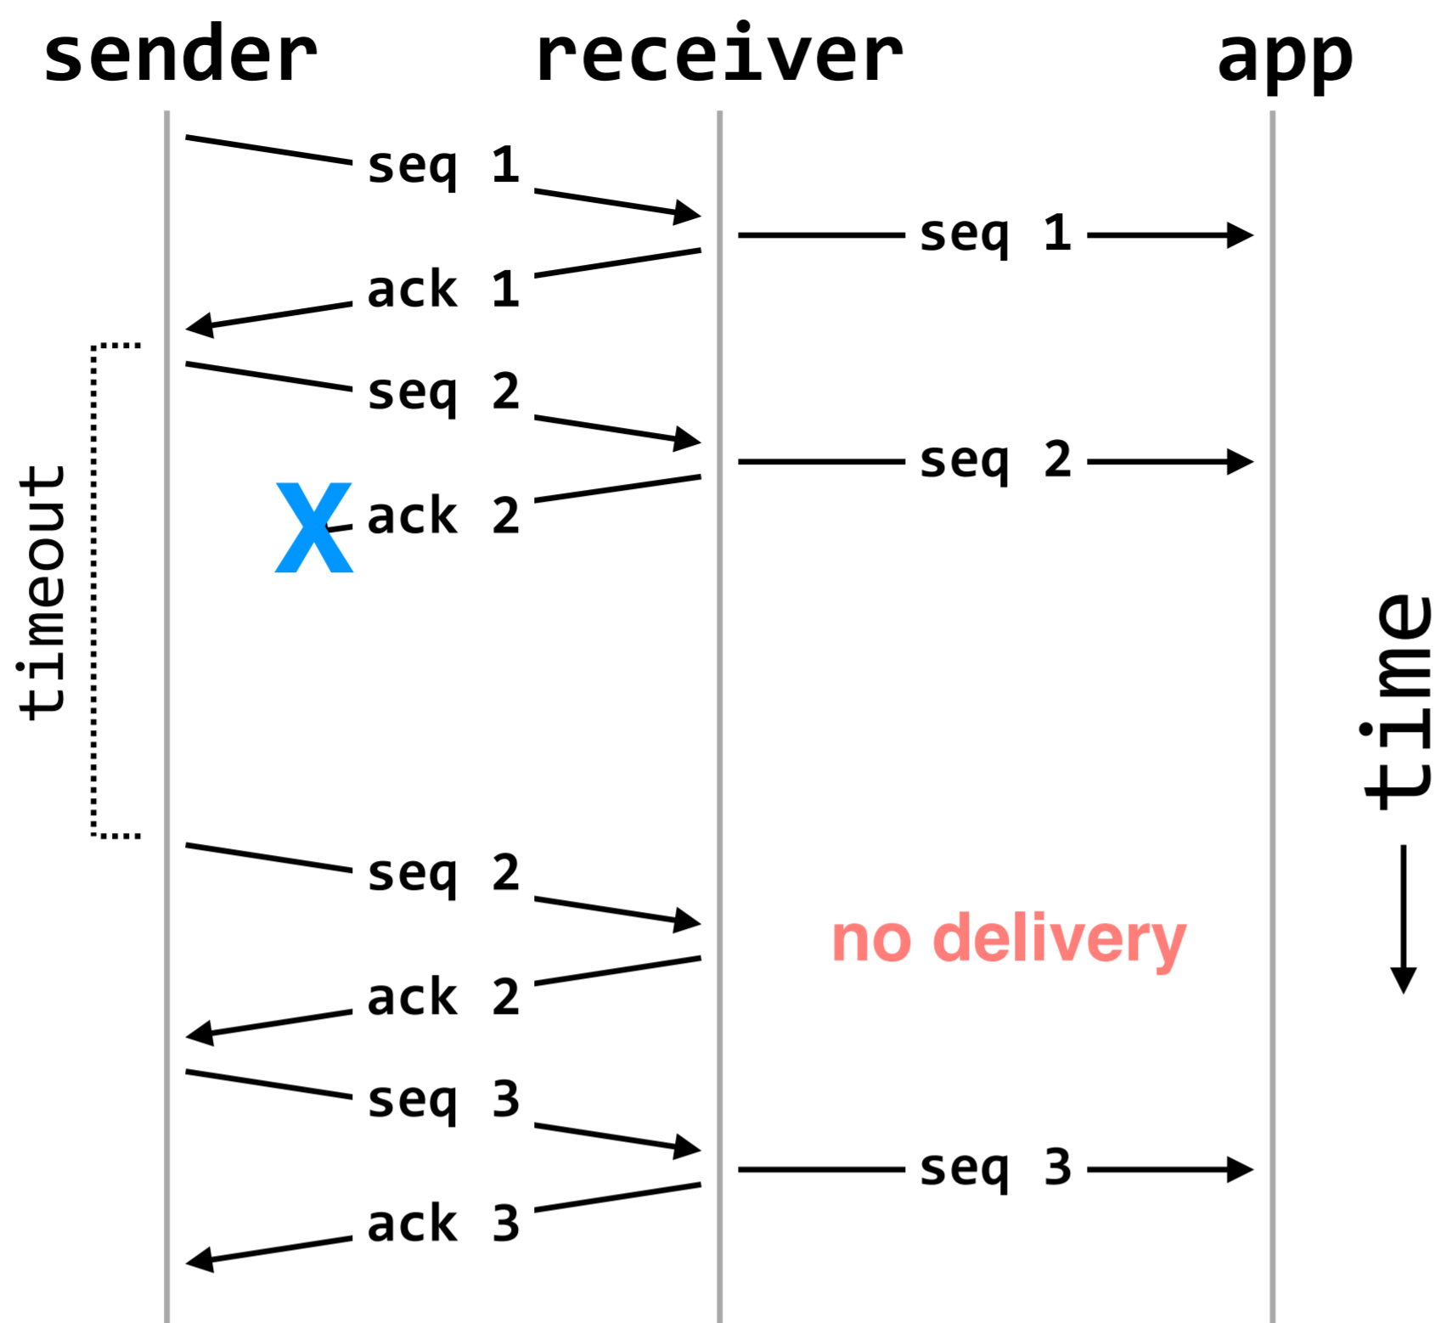
What to do in Failure?

Slide 11
Wireshark

Slide 12
What is Wireshark?
Free and open-source packet analyzer
Used for network troubleshooting, analysis, software and communications protocol development, and education
Open Wireshark--what activity can you log?
What kinds of protocols do you see?
What happens if you follow a TCP stream?

Slide 13
Problem
Can you find the password sent in “pcap”?

Slide 14
Problem
Can you find the flag in “traffic-5”?

Slide 15
Problem
The police have retrieved a network trace of some suspicious activity. Most of the traffic is users viewing their own profiles on a social networking website, but one of the users on the network downloaded a file from the Thyrin Labs VPN and spoofed their IP address in order to hide their identity. Can you figure out the last name of person that accessed the Thyrin files, and the two source IP addresses they used? [Example valid flag format: "davis,192.168.50.6,192.168.50.7"].
Use “traffic.pcap”

Slide 16
Fun Unrelated Problem
Can you find the flag in pdf.pdf?

Slide 17
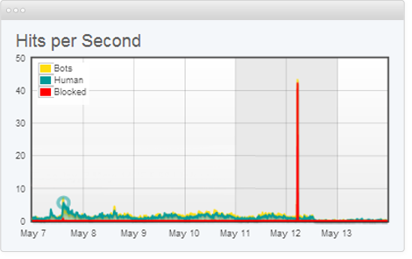
What are DDOS attacks?
A distributed denial of service (DDoS) attack is a malicious attempt to make an online service unavailable to users, usually by temporarily interrupting or suspending the services of its hosting server.

Slide 18
How Do They Work?
A DDoS attack is launched from numerous compromised devices, often distributed globally in what is referred to as a botnet.
Volume Based Attacks (bits per second)
Protocol Attacks (packets per second)
Application Layer Attacks (requests per second)
Notes:
https://www.imperva.com/learn/application-security/ddos-attacks/

